Slide 1
Using Open Data to Drive Innovation and Empower a Nation of Data Users
John H. Thompson
Director of the U.S. Census Bureau
Notes:
The U.S. Census Bureau is to the premiere source of data on our America’s people, places and economy. We have a lot of data that is really valuable to businesses, communities, local governments, and individuals, and our goal is to make it as accessible as possible. As part of our efforts to provide rich data assets to the public, we’re currently embarking on a modernization that is perhaps the most aggressive in our 200+ year history.
The census is a massive undertaking – it’s the largest peacetime mobilization effort in the U.S. The scale of our operation requires us to be smart about using data science approaches to improve our operation. To give you an idea of where we’ve come from, almost 50 years ago – heading into the 1970 Census operation – we transformed how our agency operated with the first ever mail-and-return Census, in collaboration with the U.S. Postal Service. That was a game changer at the time.

Slide 2
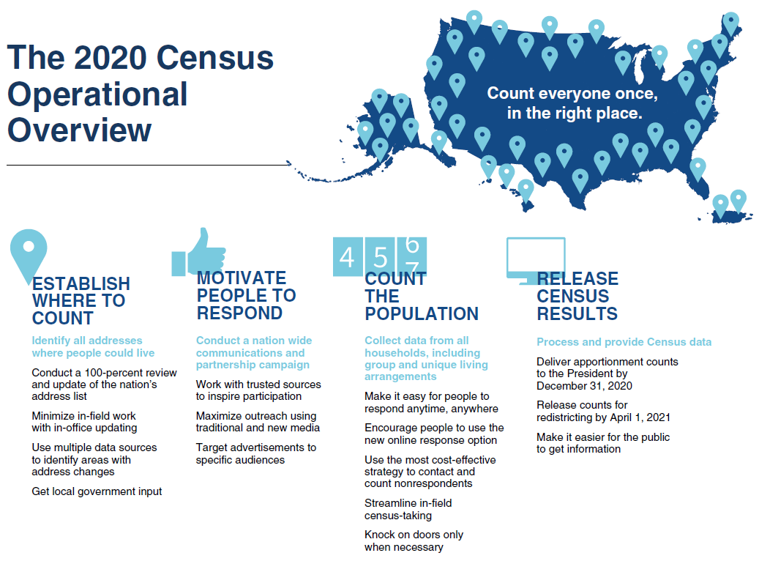
The First-Ever Digital Census
Notes:
Now, half a century later, we’re ramping up for our first-ever digital census in 2020. Innovations in data science are allowing us to be smarter and more efficient than ever before. Through the smart use of technology, we can save up to $5.2 billion, compared to repeating the design of the 2010 Census.

Slide 3




Census Bureau Data Sources
Household demographic, economic, housing, and social characteristics
Income, poverty and health insurance
Race and ethnicity
Housing
Economic indicators
Longitudinal employer-household dynamics
International trade
County business patterns
Geography
Public sector finances
And more…
Notes:
The data from the decennial census is extremely important; not only does, it also provides the population benchmark for nearly every other U.S. survey. But the decennial census is not the only source of data that we provide. The Census Bureau conducts more than 130 surveys every year, including the nation’s largest household survey – the American Community Survey.
We gather and disseminate a wealth of statistics on population and demography, down to the neighborhood level. If you want information on families and living arrangements, education, income, poverty, or health insurance - we have it. We have statistics on employment and housing characteristics. We release quarterly and annual key economic indicators. We have economic data from international trade statistics to county business patterns. We have data on public sector finances, and huge resources on geography.
We have really immense digital assets, and our data users are now (rightfully) demanding that we provide them in API format, to use in apps and data analysis projects using R and Python.
Today, I’m going to share our vision for the new Census Bureau, with some exciting initiatives we are driving with Open Data, Open-Source, and Agile – to deliver increasingly more value to the public while at the same time hitting our projected savings goals.

Slide 4

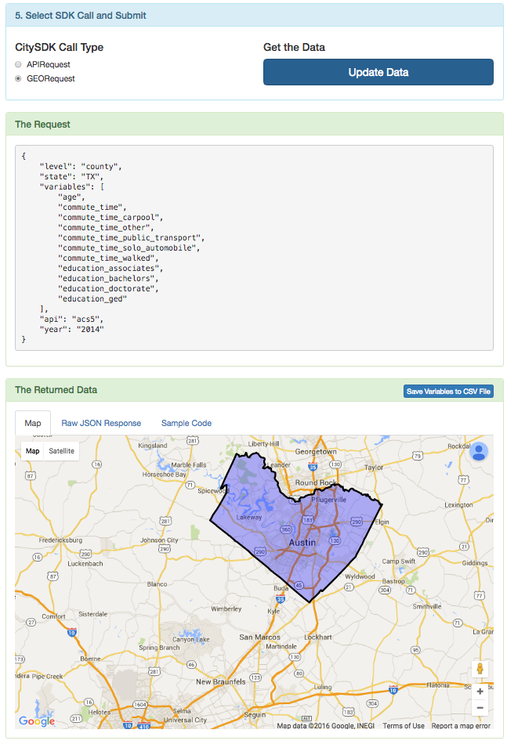
Embracing Agile and Open-Source
Set of Javascript tools, guides, and examples on Github to build web applications
Enhances usability and access to Census data through public APIs
Streamline how open data is used to build apps for cities through open-source tools
Foster an ecosystem to improve interoperability across data silos at federal and local level
Notes:
I’ll start by introducing you to our first open-source project: the City Software Development Kit. This is a toolbox whose sole purpose is to help civic hackers build apps in less time, using local and federal open data. You can use it to build social good apps, or even bootstrap a new company. Our friends in the European Union pioneered the CitySDK concept, and its potential to save governments money and deliver value to citizen is enormous. So we decided to build it for the U.S. using an Agile approach, building it all in the open on Github. The Census Bureau is leading the charge for this effort, with help from the Presidential Innovation Fellows.
CitySDK is also helping Census bring the voice of the developer as close to the organization as possible. Whether it’s the Agile development process and publically available scrumboards, or Open-source code that is pushed to the Github repo on a regular cadence – the CitySDK dev team takes best practices from industry to improve the usability and access of government data.
CitySDK is a Javascript toolbox that sits on top of the Census public APIs and other datasets, and provides access to geographic, population, demographic, and economic datasets. It’s completely open for anyone to build a module. Local and federal datasets are combined through a common interface that can be used to call multiple datasets. For example, data from the U.S. Department of Housing and Urban Development can be easily stitched together with local data from your city’s open data portal, with the CitySDK using geography as a common dimension. In the future, additional programming languages may be supported based on developer feedback.
The core of CitySDK is data that can be accessed programmatically (via an API) to solve a vertical use-case. There has been a trend in recent years for cities to open their data assets, and this isn’t limited to large urban centers: Asheville, Albuquerque, and Salt Lake City all make an appearance in the Top 15 rankings. On the federal side of things, agencies have made significant inroads in opening up data and publishing APIs as well, as required under the 2013 Federal Open Data policy.
The obvious benefit of Open Data for citizens is a more transparent government. But a powerful aspect is the possibility of using data assets to build social good applications and even for-profit companies. This empowers an entire community of software developers, designers, and makers with technical skills to “scrub in” and build apps that help improve their community.

Slide 5
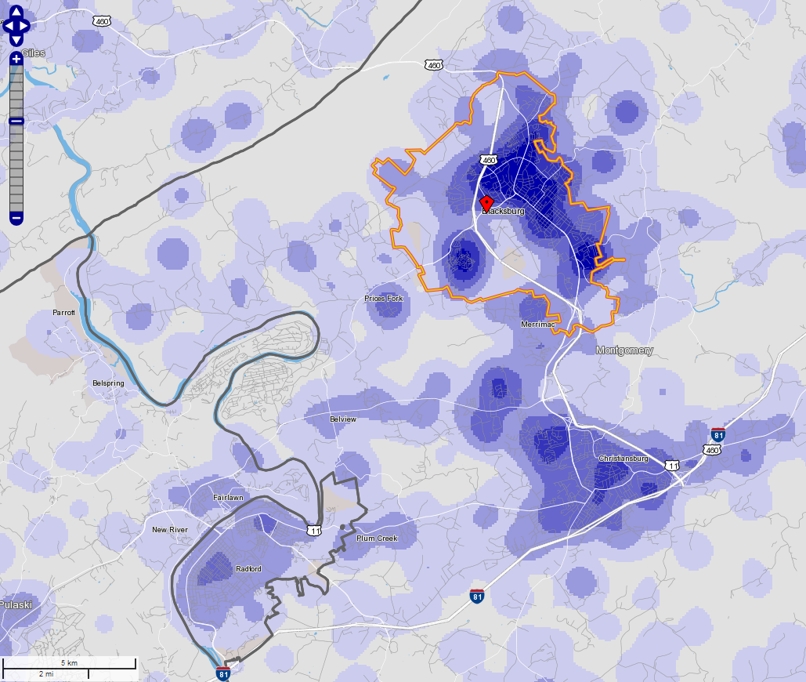
Making our Data Available for the 21st Century
Longitudinal Employer-Household
Dynamics (LEHD)
Heat map of residences for jobs in Blacksburg, VA
Produced using OnTheMap web tool based on LEHD Origin-Destination Employment Statistics
Source: Machanavaijjhala, Ashwin and Daniel Kifer, John M. Abowd, Johannes Gehrke, and Lars Vilhuber. “Privacy: Theory Meets Practice on the Map.” International Conference on Data Engineering (2008).
Notes:
An example of cutting-edge confidentiality protection is the LEHD Program in the Census Bureau’s Center for Economic Studies. The program brings together administrative, census, and survey data on workers and firms and 3 detailed, public-use data products on jobs and the workforce in the United States, covering more than 140 million jobs.
One of these data products – LODES, which currently spans 2002-2014 – describes jobs by workplace, residence, and commute flows at detailed geographies for different segments of the workforce. LODES allows users to answers questions such as, “Where do young workers who are employed within 1 mile of this transit hub commute from?” or “What share of service workers both live and work in the city?” Depicted here, is a heat map produced from the LODES online web tool, OnTheMap. The blue shading represents where workers live who hold jobs in Blacksburg, VA, which is outlined in yellow.
To protect the confidentiality of both workers and firms in this dataset, the Census Bureau uses two separate protection mechanisms: noise infusion and synthetic data. Neither method requires cell suppression. Employment counts in establishments are protected by adding noise, whereas the residential locations of workers are protected by drawing a synthetic residence from a conditional distribution of residences, whose domain includes the entire United States.
The synthetic data mechanism is the first provably private method used in a major statistical data product and is the result of an ongoing collaboration between economists, statisticians, and computer scientists. Current research is focused on understanding the privacy-utility tradeoffs inherent in statistical disclosure limitation and designing methods that improve data quality for users while still providing confidentiality protection.
Other examples of synthetic data methods that are now being used at the Census Bureau are:
SIPP Synthetic Beta, which integrates person-level micro-data from a household survey with administrative tax and benefit data. It also synthesizes all variables to protect confidentiality while preserving the underlying covariate relationships.
SynLBD is a synthetic longitudinal business microdata product that protects highly skewed payroll and employment data
Finally, the ACS Group Quarters Small Area Estimation provides synthetic interviews for not-in-sample GQ facilities.

Slide 6
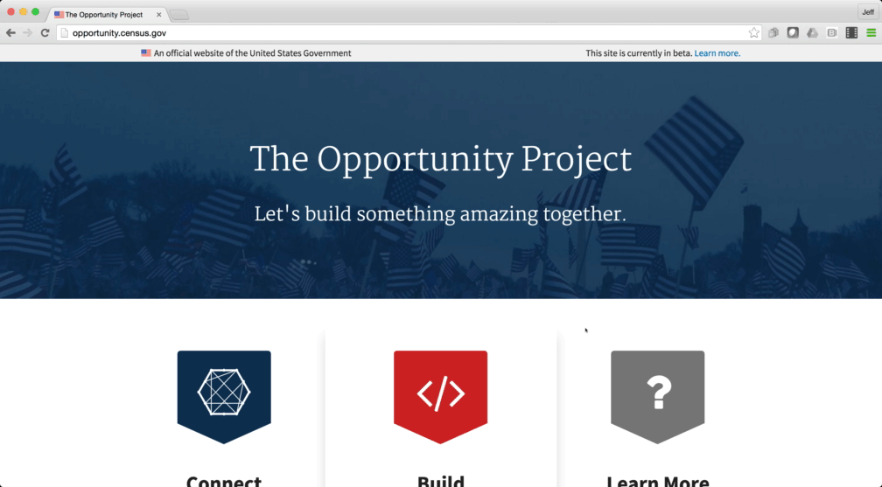
Improving Access to Opportunity
Notes:
In March, the federal government launched the Open Opportunity Project. This is an exciting public-private collaboration to help cities and local governments use new, curated, open data to account for how they use Federal housing dollars. It represents a new way that the Federal government is teaming up with local leaders, technologists, non-profits and community members to leverage data to expand access to opportunity and fair housing across the country.
This curated data set lets you navigate a wealth of information on access to jobs, transit and schools with information from American Community Survey data and other Census Bureau sources. Armed with this data on neighborhood-level opportunities and challenges, communities can expand access to opportunity for their members.

Slide 7

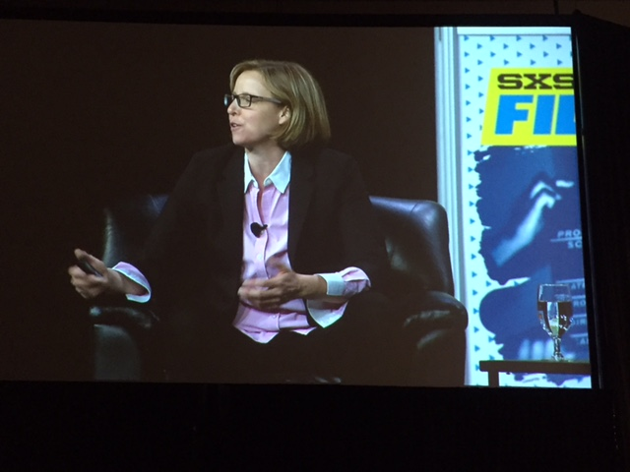
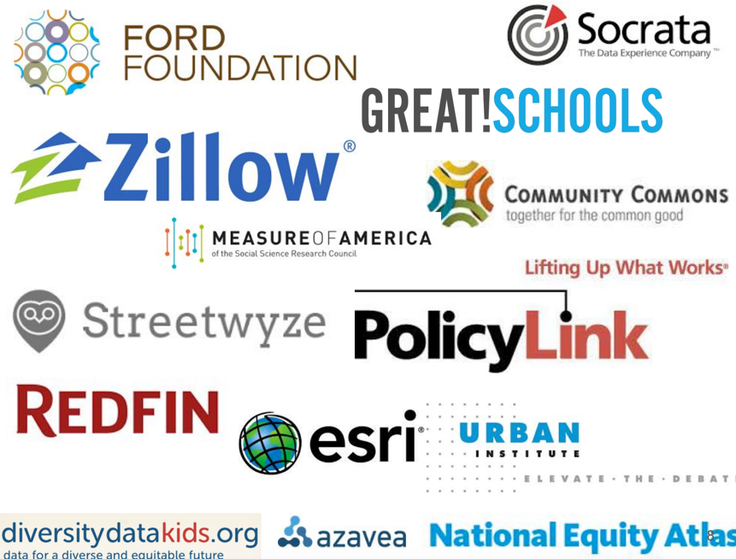
Improving Access to Opportunity
Launch event at SXSW in Austin, TX
Over 20+ News Articles covering
The Opportunity Project launch
Notes:
As part of the project, in January the government brought together eight cities and a dozen private sector and non-profit software development teams to use Open Opportunity Data.. Some of the participants included developers from Zillow, Redfin and Socrata; experts from the Urban Institute and Ford Foundation; and local data leads from New Orleans, Baltimore and Philadelphia. We helped these power data users add new capabilities that empower communities to increase opportunity through user-friendly digital tools The tools they came up with visualize everything from school test scores to community health outcomes to median commute times.
All of this information is now at your fingertips at opportunity.census.gov. This platform links to Open Opportunity digital tools and provides clear pathways for you to access the data, build new tools, and connect with others through a community of practice. It’s an interactive site that invites software developers, data users, community leaders, and local governments to learn, connect and build.

Slide 8
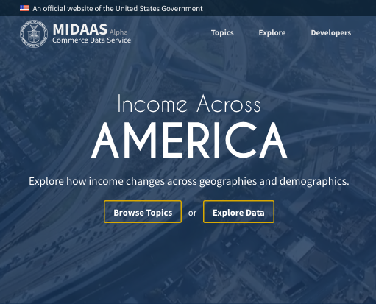
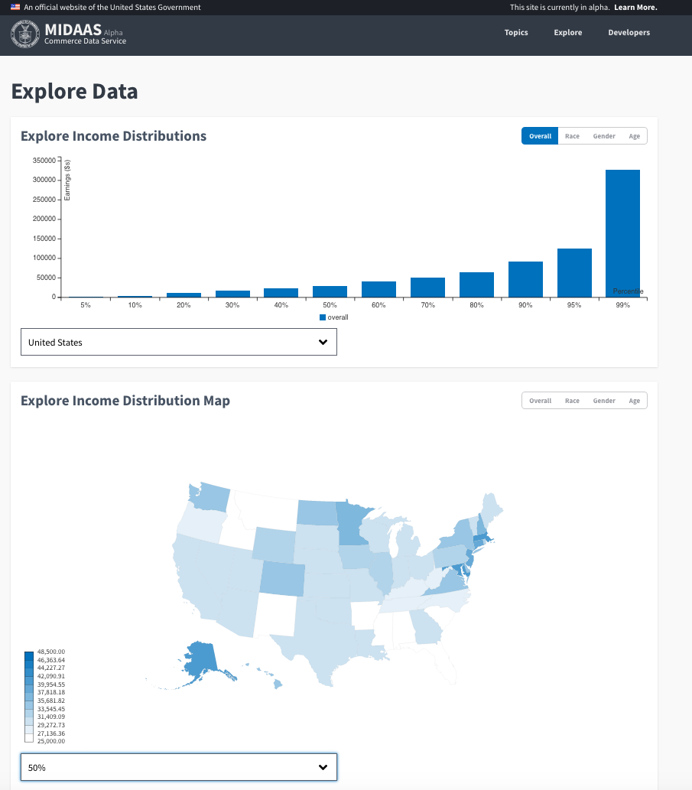
Understanding Income Data
Notes:
Another recent project that we’ve undertaken (with the Commerce Data Service and the Presidential Innovation Fellows) focuses on data that illuminates issues around income gaps and income inequality. We want to give stakeholders easy and convenient access to this data in order to facilitate a robust and informed discussion, and to build solutions.
The Census Bureau produces Public Use Microdata Sample (PUMS) data from the American Community Survey that provides detailed, aggregated information on individual people and housing units. This spring, we announced the Alpha release of MIDAAS (Making Income Data Accessible As a Service). MIDAAS is an API, website, and developer toolkit that enables you to explore income data from Census – and, soon, from the Bureau of Labor Statistics – in an intuitive manner. By opened up these new datasets as APIs, we allow easier access for researchers and the ability to create compelling visualizations
Our goal is to help Americans better understand the complicated and complex issues surrounding income distribution in America. In addition, we hope to accelerate developers’ ability to integrate government data into their projects. In the spirit of openness and transparency, we’re doing development and collaborating on Github.

Slide 9
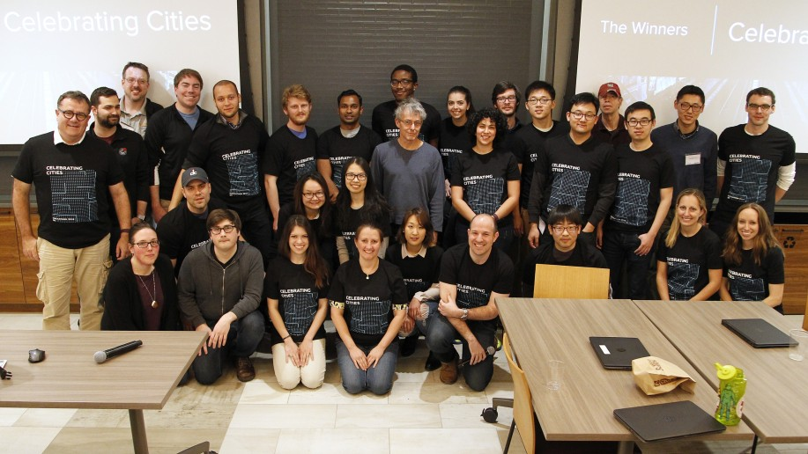
Hacking the Last Mile
Notes:
In February, we collaborated on a Celebrating Cities Hackathon with Uber, the U.S. Department of Transportation, and others. The hackathon focused on ways that the public and private sector could work together to help travelers complete the “last mile” of their journeys. Nine teams designed solutions to help local residents better connect to their cities using data from the Census Bureau, the Department of Transportation, and the Department of Housing and Urban Development.
The teams used Census data from the American Community Survey and Longitudinal Employer-Household Data (LEHD) was key. LEHD is a jobs frame that pulls from state data and federal workers. Census economists and computer scientists collaborated to create LEHD origin-destination employment statistics that covers 135 million jobs. They tabulated counts of jobs by workplace, residence, and job and worker characteristics (that is, industry, earnings, age and educational attainment).
This is an incredibly rich data source that’s made possible through the use of synthetic data. With synthetic data, we’re able to provide detailed and accurate data while still protecting the confidentiality of our respondents. Some of the features we’ve introduced include drawing residences from a conditional distribution whose domain includes the entire U.S., and adding noise to the distribution to protect individual data. We also avoid cell suppression, although this can lead to less accuracy for smaller flows. We’re continuing to research on how we can improve and innovate with synthetic methods.

Slide 10
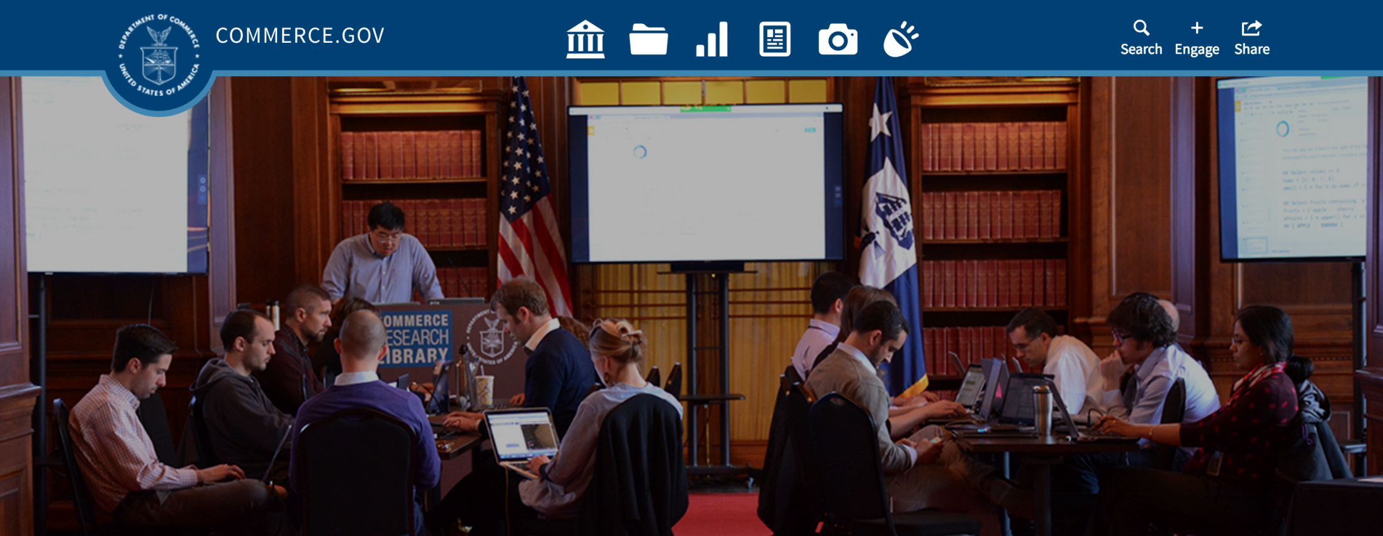
Commerce Data Service
Commerce Data Service
Notes:
As you can see, the Census Bureau – and more broadly, the Department of Commerce, which we’re part of – really embraces this model of data dissemination. We’re constantly working on ways to become an innovative and stronger data-driven agency.
In that vein, last November the Department announced the creation of the Commerce Data Service. This is a public startup that’s working to deliver products and services to help government agencies better deliver information to their customers. It was organized as a new shared services model to tackle core infrastructure issues and raise the standards of software development throughout the Commerce Department.
In January, the Data Service partnered with General Assembly to offer classes to Commerce employees in Agile Development, HTML and CSS, storytelling with data, and Excel. They hoped to enroll 30 people in each class – but ended up more than tripling their goal, with 422 registrations.
The enthusiastic response led them to start thinking about how to train employees in data science, data engineering, and web development on a bigger scale. The Data Service now offers two-week bootcamps on “Data Analysis & Discovery” and “Data Visualization for Policy,” as well as 14 other courses that have seen over 3,500 registrations. They also implemented an innovative funding model, where they provided scholarships for select employees to take courses in exchange for a three-month assignment in the Data Service to work on a project for their home bureau.

Slide 11
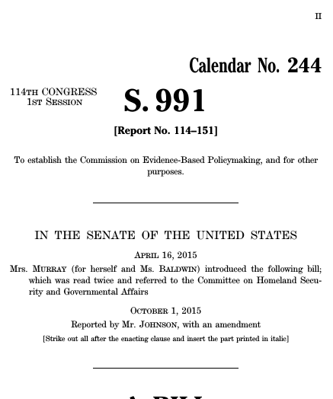
Evidence-Based Policymaking Commission
Determine optimal arrangement for integrating and disseminating federal administrative and survey data and statistical data series
Recommend data infrastructure, database security, and statistical protocols
Recommend outcomes measurement and rigorous impact analysis
Consider a clearinghouse for federal program and survey data
Participation from Census Bureau, IRS, OMB, BLS, Bureau of Economic Analysis, Social Security Administration, HHS, Agriculture, HUD, Education, Justice
Notes:
Earlier this year, Congress passed the Evidence-Based Policymaking Commission Act. The bill sets up a 15-member commission to comprehensively study the data inventory, infrastructure, security, and statistical protocols that are used in federal policy making.
The commission’s goal is to make government data resources more widely available for program evaluation, continuous improvement, and research. In that vein, it will determine an optimal arrangement for integrating federal administrative data, survey data, and statistical data series. Commission members will be looking at data linkages across administrative records, and data merging for research purposes. Another exciting aspect of their mission is to consider the creation of a government-wide clearinghouse for program and survey data that can be used in evaluation and policy making. Of course, as they look into how to make this data available for use, they’ll also be weighing how to best protect it and ensure individual privacy and confidentiality.
The Evidence-Based Policymaking Commission will be housed at the Census Bureau, with participation from the IRS, Bureau of Labor Statistics, Bureau of Economic Analysis, White House Office of Management and Budget, and other agencies (Social Security Administration, Departments of Health and Human Services, Agriculture, Housing and Urban Development, Education and Justice). I’m excited for the Census Bureau to spearhead this project that is really taking us into the next generation of open government.

Slide 12
Invitation to the Census
Open Data Workshop
Want to learn about our APIs, SDKs, and see some examples for data scientists?
Please join us for our
Open Data workshop tomorrow
Sunday 11:00 am – 12:30 pm
Room 209.
Workshop Topics:
Census APIs
CitySDK
R
Python
Tableau
Datasets:
American Community Survey
LEHD
Notes:
Before we wrap up, I wanted to invite you to join us tomorrow for our Open Data Workshop. This session will include hands-on exercises on using Census data in R, Python, and with tools like Tableau.

Slide 13
Thank You
We want to hear from you on how you use our data. To complete a user interview, please contact: jeffrey.meisel@census.gov
Follow us on Github:
https://github.com/uscensusbureau/
Notes:
It’s our hope that these exciting innovations with data science will empower a nation of data enthusiasts, like you. These are just some of the examples of how the Census Bureau is working to make our data as widely accessible as possible. We’re committed to transparency and openness, and I’m really proud of the great tools that we’re bringing out to further that commitment.
If you’re one of our data users, I encourage you to reach out to us with ideas or suggestions for how we can improve your experience. Please reach out to US Census Bureau on Github, or contact Jeff Meisel. We look forward to continuing to serve you as data users and expanding your access to critical data. Thank you.

